Slide 1
Curve
Presented By:
Dr. Sk. Md. Masudul Ahsan
Professor
CSE, KUET
Md Nazirul Hasan Shawon
Lecturer
CSE, KUET

Slide 2
Outlines
What You Will See Today
Screen Coordinate to World Coordinate System
Viewport
Viewport Transformation
Bezier Curve
References

Slide 3
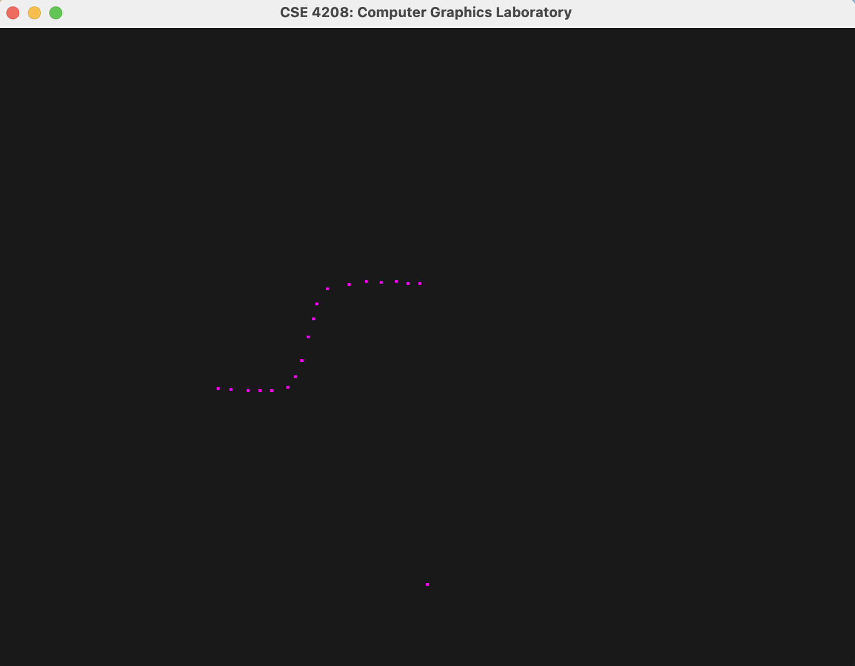
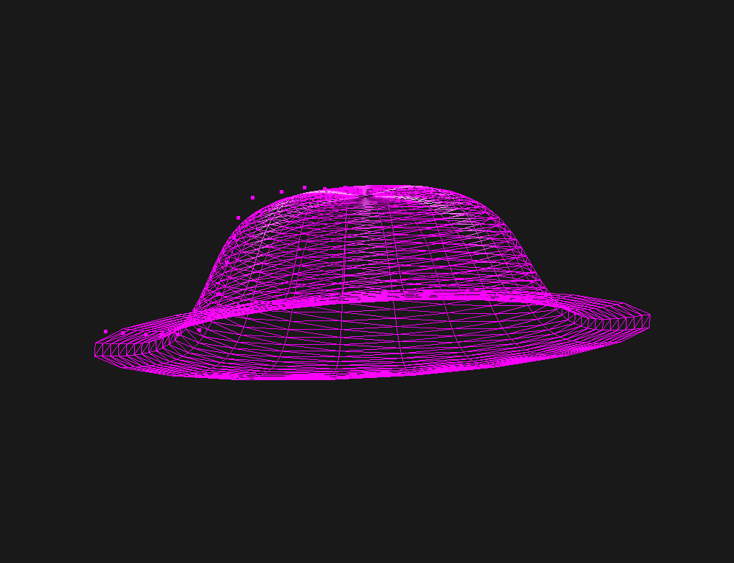
What You Will See Today

Slide 4
Screen Coordinate to World Coordinate System
Screen Coordinates
World Coordinates
Viewport
Projection
View
Model
-1
World Coordinates
Screen Coordinates
Viewport
Projection
View
Model

Slide 5
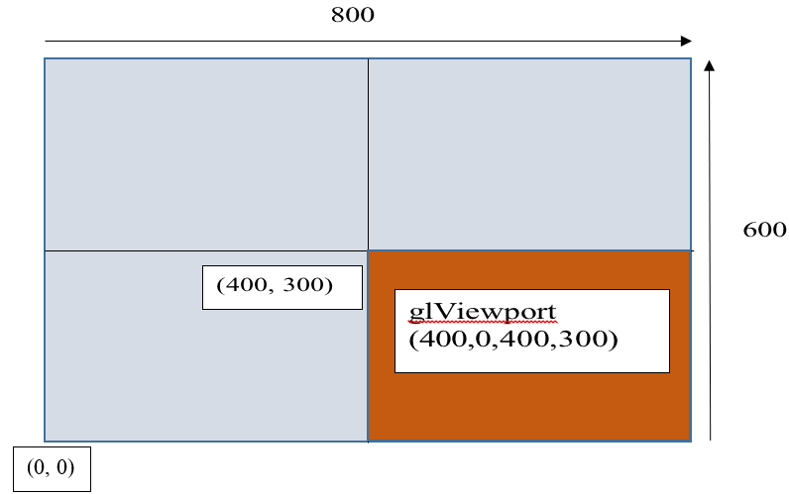
Viewport

Slide 6
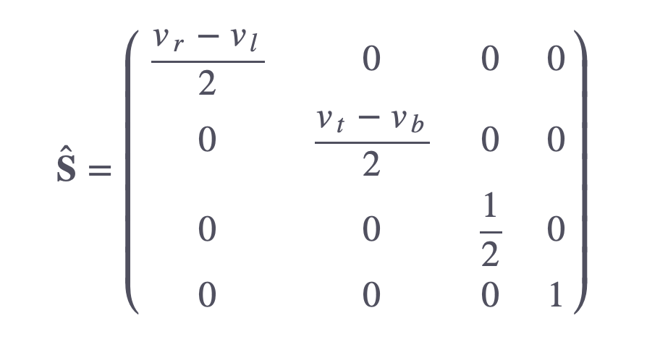
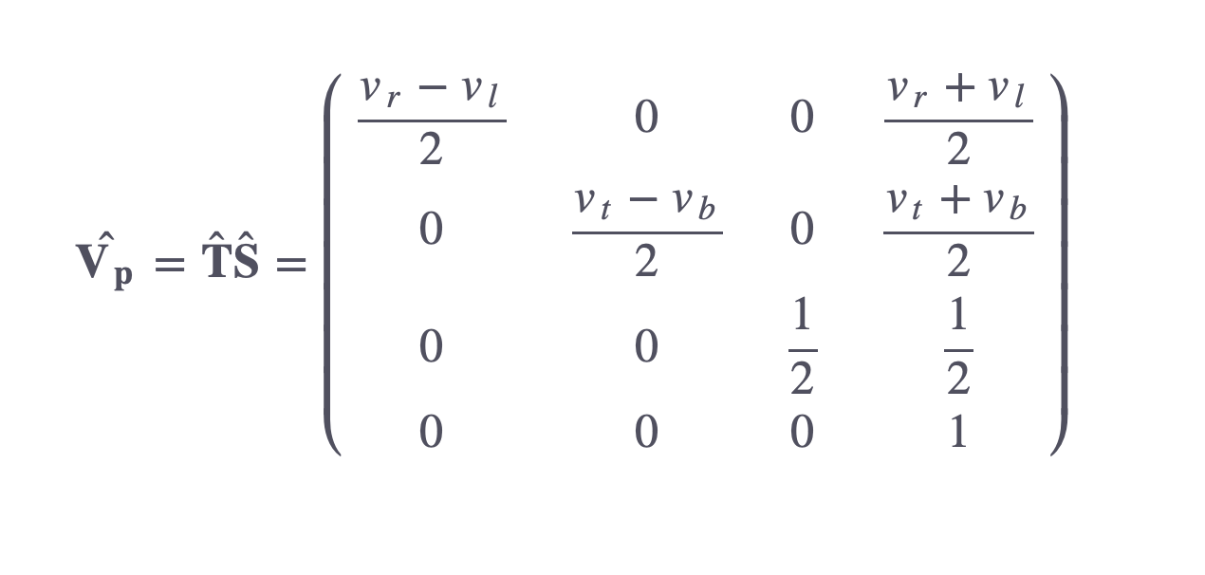
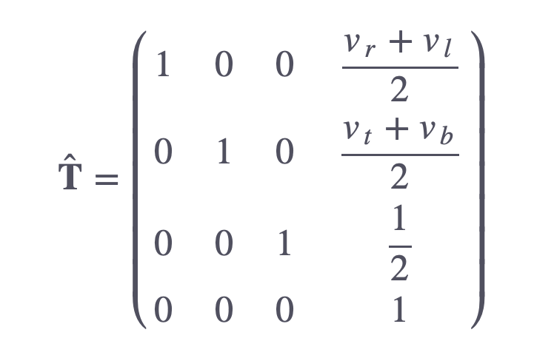
Viewport Transformation

Slide 7
Important Note
Remember to invert the mouse’s y-coordinate since the y-coordinates of the window go from bottom to top whereas the y-coordinates of the screen go from top to bottom.
For depth value (Z), you can manually go from -1 to 1 ( zNear, zFar ).
Set w = 1.0 (Homogeneous Coordinate)

Slide 8
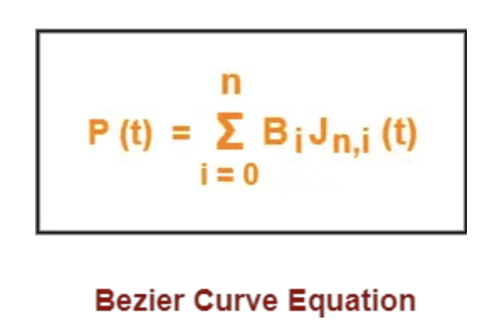
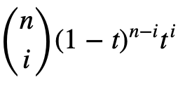


Bezier Curve
$$Jn,i$$
(t)
$$=$$

Slide 9













3D Object Drawing
Z = r cos (theta)
X = r sin (theta)
Y same for all the points on the circle

Slide 10
References
https://stackoverflow.com/questions/7692988/opengl-math-projecting-screen-space-to-world-space-coords
https://glasnost.itcarlow.ie/~powerk/GeneralGraphicsNotes/projection/viewport_transformation.html#:~:text=The%20Viewport%20Transformation&text=The%20u%20and%20v%20coordinates,depth%20value%20will%20be%20called%20.
https://www.gatevidyalay.com/bezier-curve-in-computer-graphics-examples/

